Slide 1


Internship Project Presentation on “Banking Management System”
Student: Sachin Kumar
USN: 1RN20CS119
Guide: Prof. Mamatha Jajur
Assistant Professor
Dept. of CSE
Department of Computer Science and Engineering
RNS Institute of Technology
2023-24

Slide 2
CONTENTS
INTRODUCTION
OBJECTIVES
PROBLEM STATEMENT
METHODOLOGY
RESULTS AND DEMONSTRATION
CONCLUSION

Slide 3
INTRODUCTION
The Banking Management System is an Application for maintaining a person's account in a Bank.
The system provides the access to the Customer to create an account, deposit/withdraw the cash from his account, also to all accounts present.
The main purpose of this project is to simplify the tedious task of banking by providing basic banking service in a user friendly environment.
It also aims at increasing the efficiency and reducing the drawbacks of existing manual banking process, thus making it more convenient for the customers to do banking as when they require

Slide 4
OBJECTIVE
To develop a software for solving financial applications of a customer in banking environment in order to nurture the needs of an end banking user by providing various ways to perform banking tasks.
Also to enable the user's workspace to have additional functionalities which are not provided under a conventional banking software.

Slide 5
PROBLEM STATEMENT
Keeping track the all activities and their record on paper and error. It is also very efficient and a time consuming process of observing continuous increase in number of client visiting the bank. Recording and maintaining all the client record highly unreliable, inefficient and error pron.
The problem facing the current manual system is difficult to update and maintain, inconsistent data, insecurity, difficult to impose different various data files and difficult to data backup.

Slide 6
METHODOLOGY
Tools and Technologies used: HTML, Bootstrap, JavaScript, PHP, MySQL
Software Requirements:
Operating System :Windows 7 Above
IDE :Microsoft Visual Studio with C++ 2022
Other Requirements :Xampp, MySQL Workbench, Notepad++
Hardware Requirements:
Processor :Intel Core i3 processor
Processor :Speed 1.70 GHz
RAM :4 GB
Storage Space :40 MB
Monitor Resolution :1024*768 or 1336*768 or 1280*1024 Software Requirements:

Slide 7
METHODOLOGY
Major Entities
Branch: This includes information about the different branches of the bank present .
Feedback: This includes information about the feedback presented by the customers to the bank.
Login: This includes information about the Login details of all the customers who have their account
in the bank.
Notice: This includes information about the all the notification sent by the bank to the customers
regarding their account.
Other accounts: This includes information about the account details of the customers who have
account in different bank.
Transaction: This includes information about the all the transaction details of the customers .
User accounts: This includes the information about the details of the customers who have their account
in the bank.

Slide 8
METHODOLOGY
Funtionalities
Login page to give access to privileged Admin.
Adding card details details by the Admin.
Changing the id and password of the staffs. which stores the details of transaction.
Admin can check all details and modify them.
Admin can delete the entities in the tables.
Easy search facilities to get the required information.

Slide 9
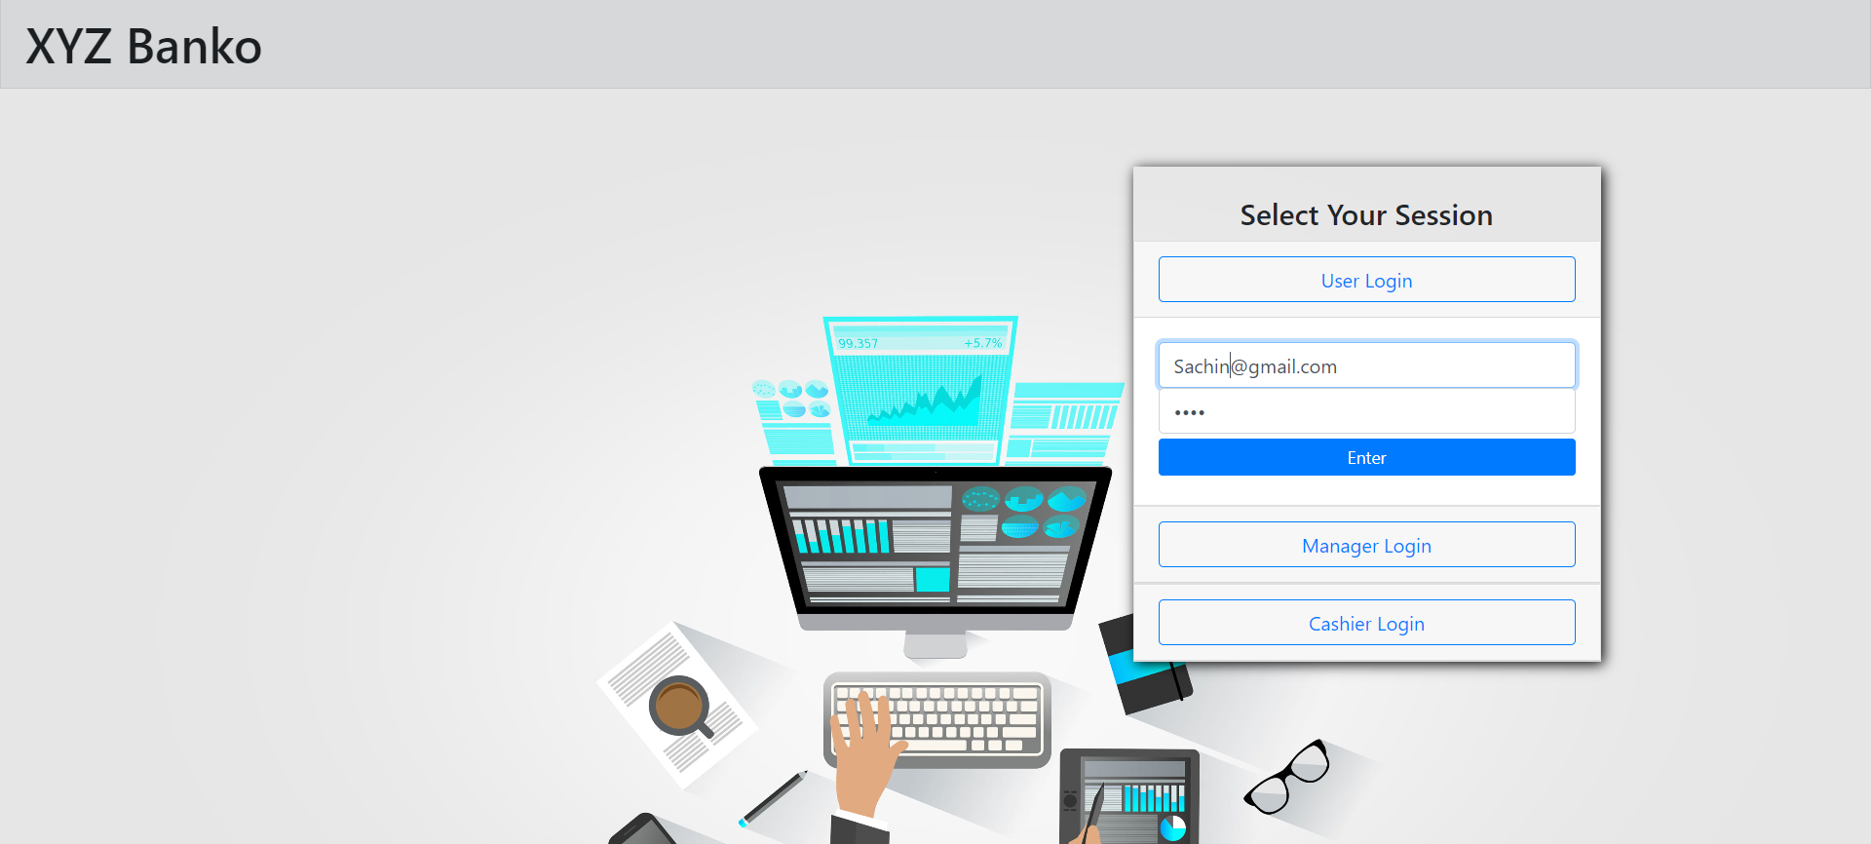
RESULTS AND DEMONSTRATION
Main Login Page

Slide 10
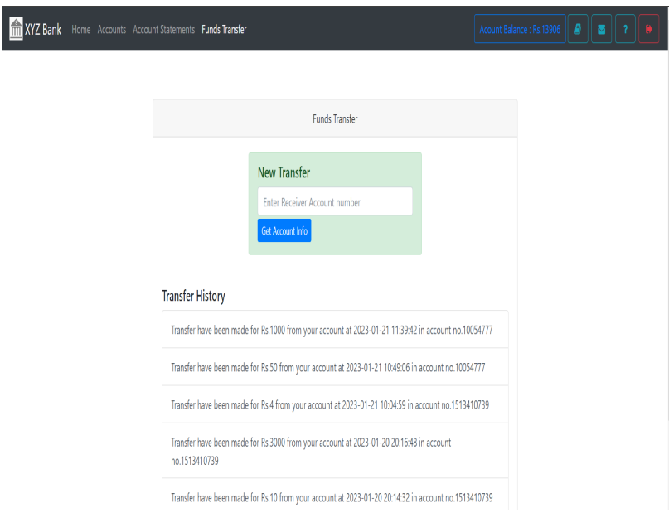
RESULTS AND DEMONSTRATION
Funds Transfer By User

Slide 11
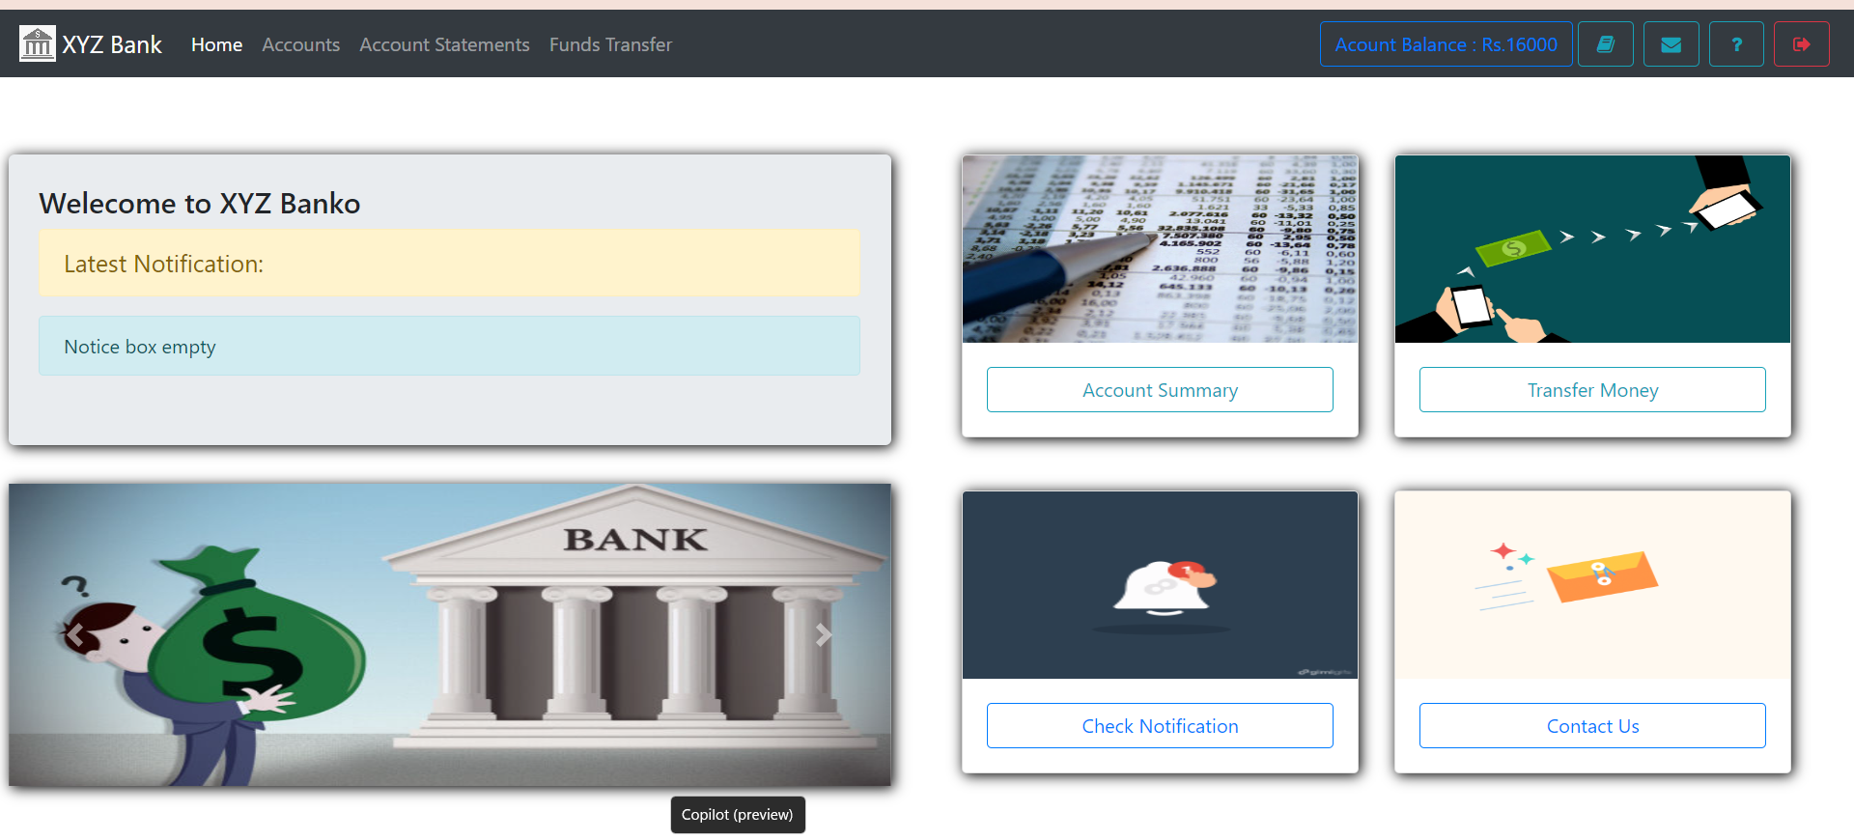
RESULTS AND DEMONSTRATION
User Dashboard

Slide 12
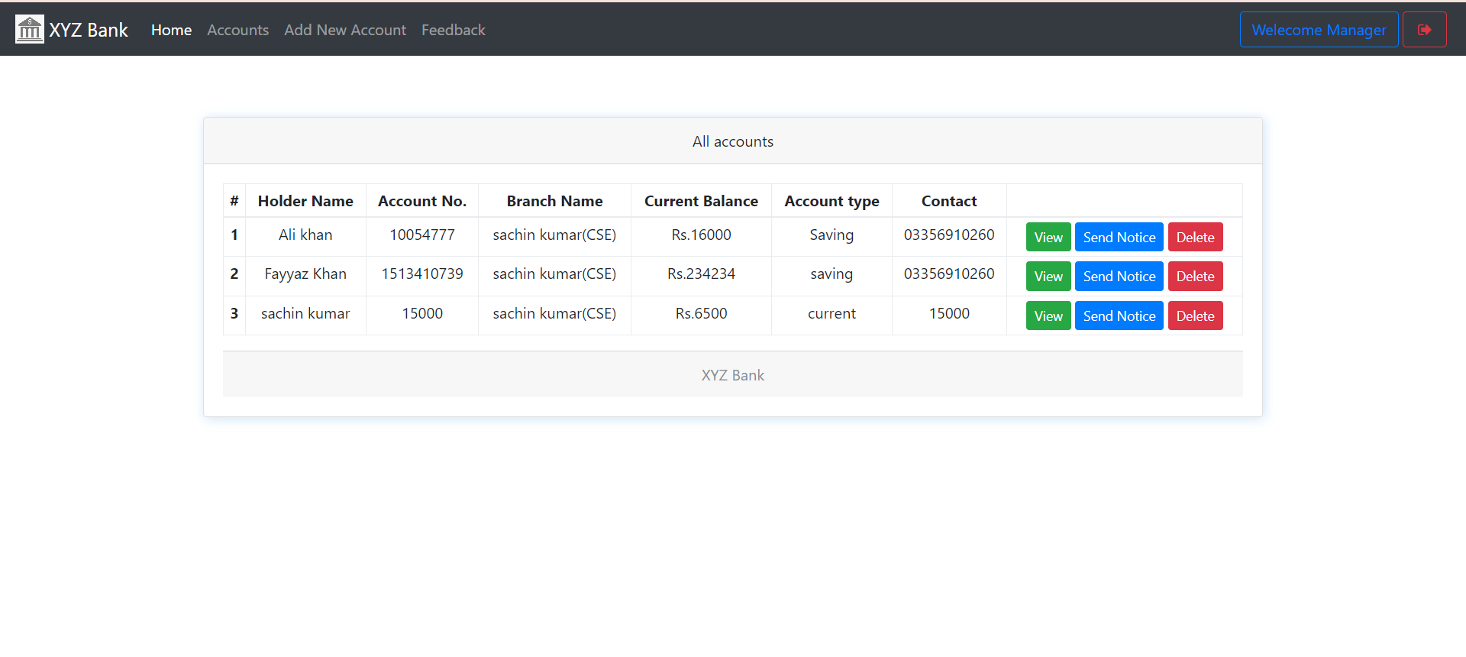
RESULTS AND DEMONSTRATION
Manager Dashboard

Slide 13
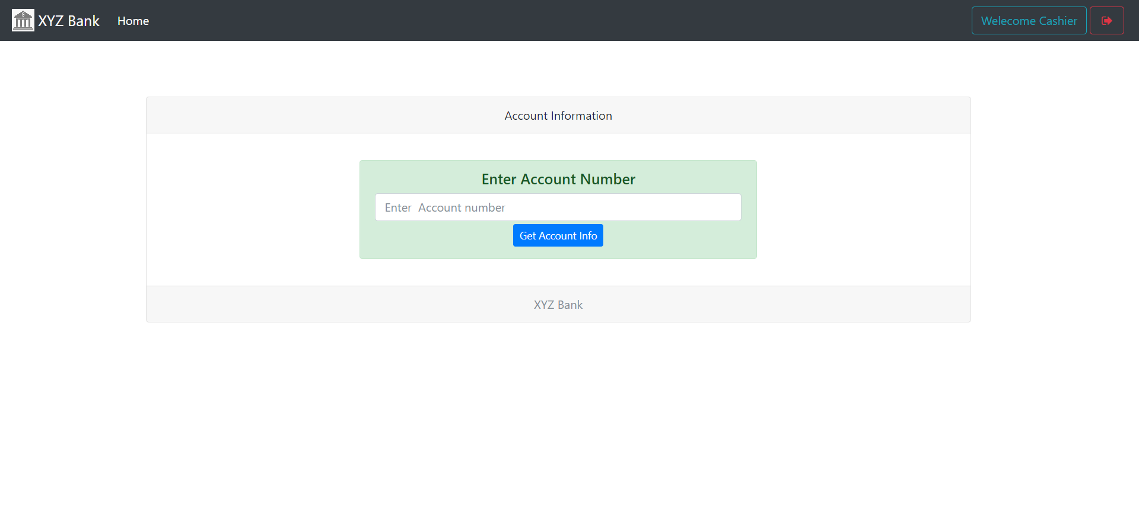
RESULTS AND DEMONSTRATION
Cashier Dashboard

Slide 14
CONCLUSION
The system provides a variety of features, including account management, online banking, loan management, reporting, fraud detection, risk management, and compliance.
The system is user-friendly, secure, and scalable, with a variety of reporting and analytics tools to help bank management make informed decisions.

